Slide 1
E-commerce Sales Analysis
Using Power BI
Team Members:
1.Parth Kulkarni
2.Onkar Tulshigar
3.Dhruv Sawrkar

Slide 2
Problem Statement:
To analyze e-commerce sales performance and customer behavior using Power BI to identify trends and support business decisions.

Slide 3
Dataset:
E-commerce sales dataset (CSV)
Contains: Sales, Category, Region, Date
Used for analysis of business performance

Slide 4
Data Cleaning:
Removed missing values
Removed duplicates
Converted date format
Checked data types

Slide 5
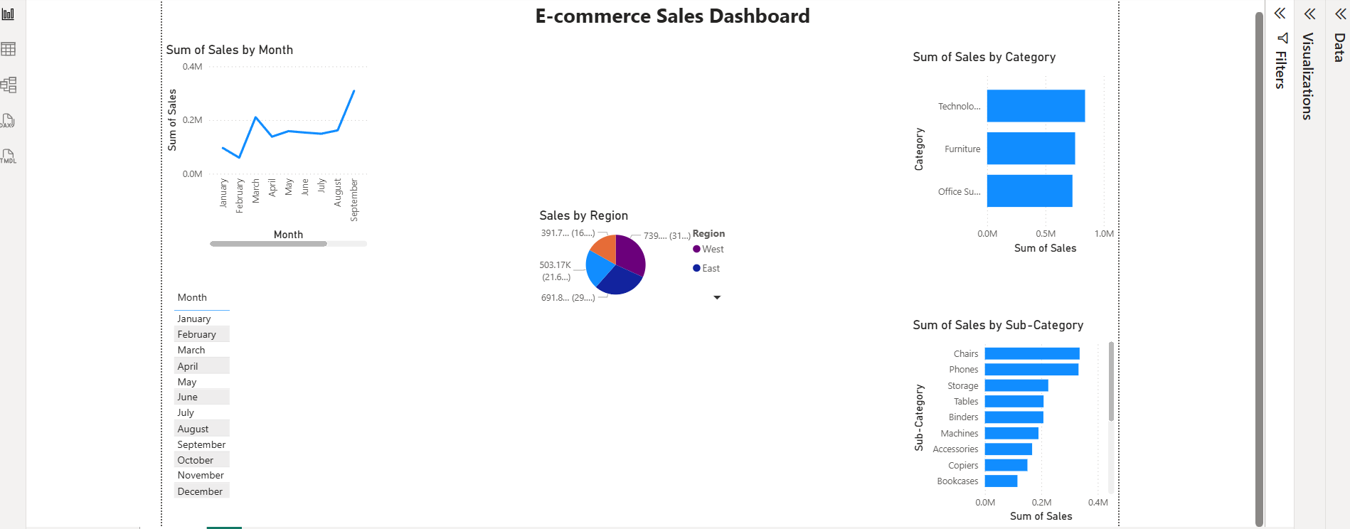
Dashboard:
Dashboard shows sales trends, category analysis, and regional performance

Slide 6
Key Insights:
Technology category has highest sales
West region performs best
Sales vary month-wise
Top products contribute major revenue

Slide 7
Conclusion:
The project helped analyze sales performance and identify important business insights using Power BI.

